Slide 1
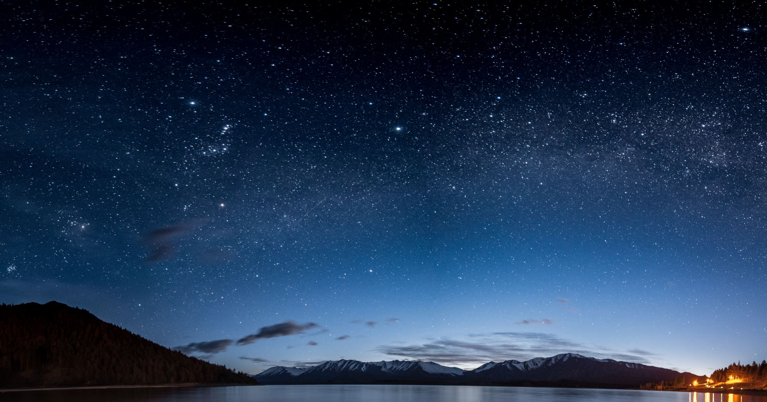
FRB (Fast Radio Burst) Visualization and Prediction
Anish Ivaturi

Slide 2
Research Objective
Objective
Hypothesis
Investigate the Spatial Patterns of Fast Radio Bursts(FRBs)
Creating a model that can predict the next FRB’s location, and capture using astronomical tools.
Creating a spatial map of the universe to better visualize
FRBs are clusters and found patterns
Determining better origins of FRBs

Slide 3
Numerical Results
Analysis
Dec and RA prediction has lower error and R^2 showing stability
RA have high RSME and MAE
Low R^2 shows the model struggle to explain the prediction variations
Metric | RA (degrees) | DEC (degrees)
RMSE | 51.0681 | 22.5216
R² | 0.1230 | 0.2258
MAE | 51.0681 | 22.5216

Slide 4
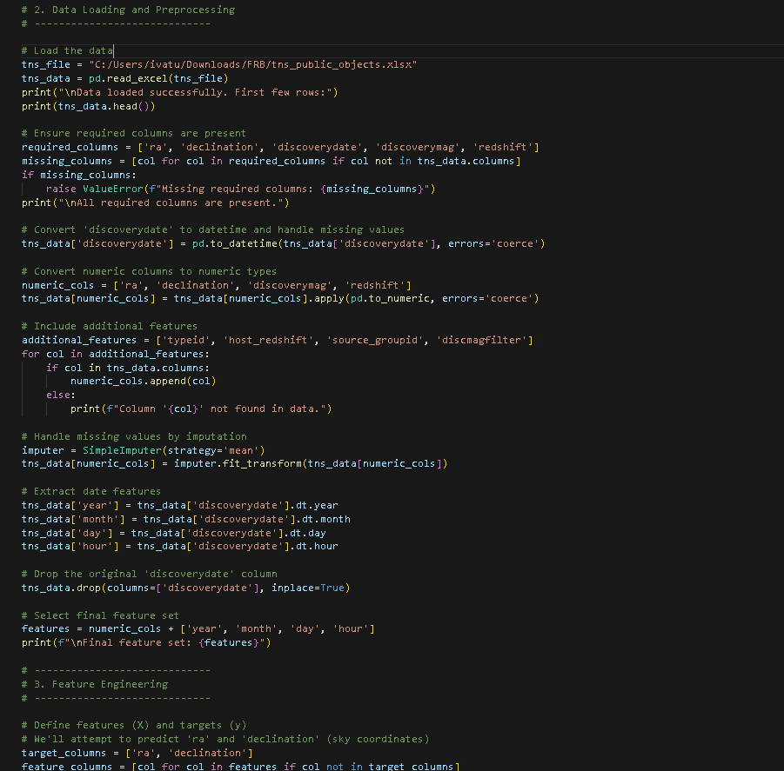
Material and Methods
Handled missing values and imputated
Converted discovery date into day month hour and years
Selected relevant features needed
https://github.com/ivaturianish/Senior_Research

Slide 5
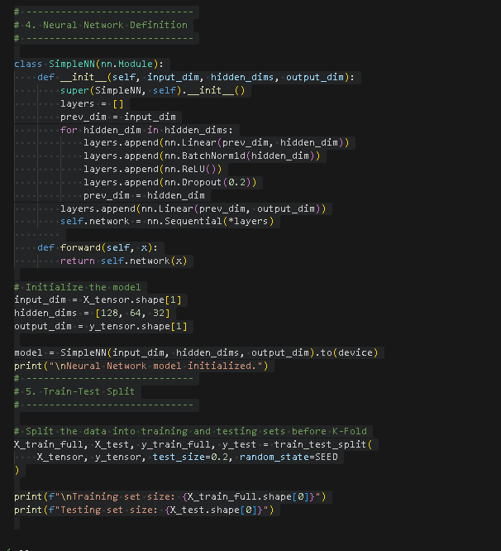
NN architecture
Model Design and configs
Develop a multitask neural network (MTNN)
Converted target variables into Sin and Cos
(ra_sin,ra_cos,dec_sin,dec_cos)
Utilized Linear, BatchNorm1d, ReLU, and Dropout layers

Slide 6
The results
The bads
The goods
Insufficient data diversity
High RSME in RA predictions
Low R^2 scores
Lot of data noise
Computational constraints for better models
Multitasking efficiency
Stable RSME and R^2
Potential for real time predictions
Scalability is there
Neural network which could expand

Slide 7
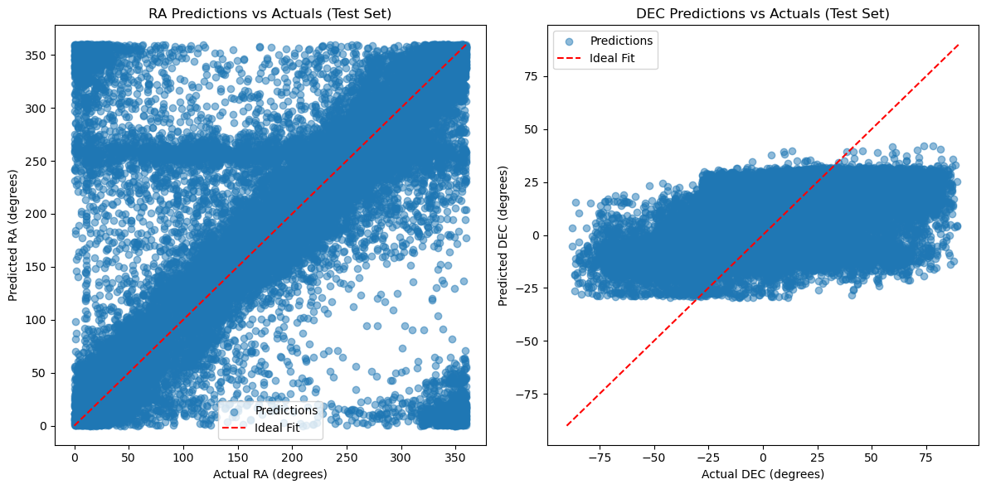
More results

Slide 8
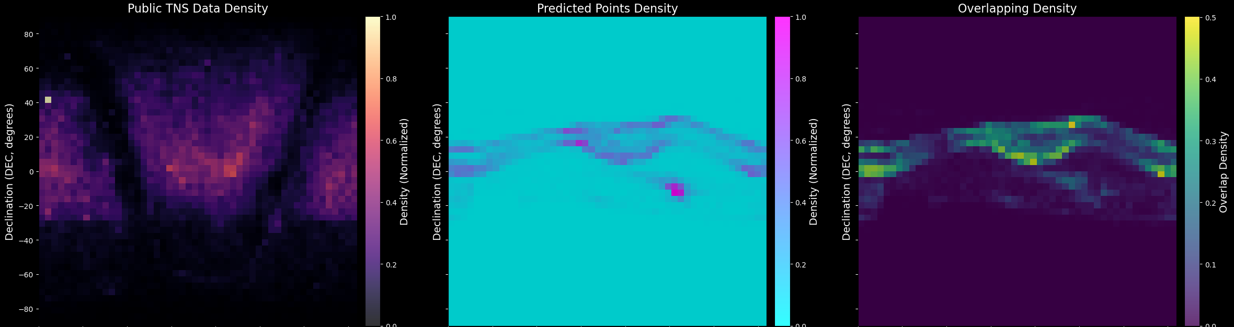
More results

Slide 9
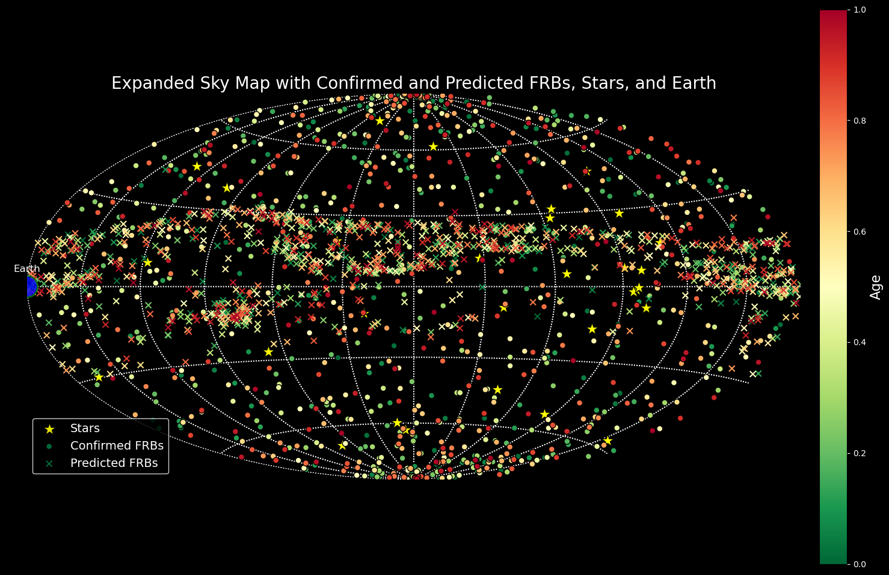

Slide 10
Takeaways
Remaining Tasks
Accomplishments
Future goals
Use current data and keep training the model
Fine tune the model for better results, and handle overfitting
Analyze how to incorporate time-based patterns to the FRB
Enhanced RA and DEC and allows efficient telescoping
Opened doors to a new model in a new field that has potential of higher prediction rate
Aiding in FRB origins
Keep model open source
Sophisticated model architectures
Real time datasets and access to larger data pools

